Slide 1
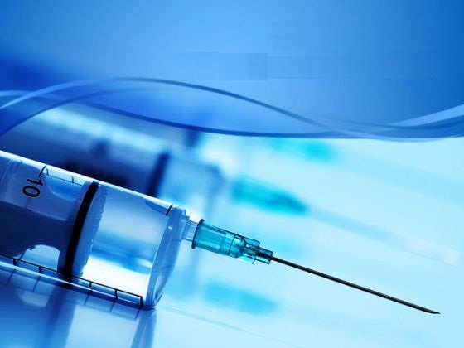
INDUCTION OF LABOUR
DR.sajda alrubaei
Consulatant Ob/gyn
Prof.Basra medical College

Slide 2
What is Induction of Labour?
Induction of labor is the artificial initiation of labour mechanism prior to its spontaneous onset.

Slide 3
Time, place & preparation
Time of induction: Preferably early morning
Place of induction: where facility for intervention and fetal monitoring is available
Preparation of Patient : Enema may be given to patients prior to induction

Slide 4
Indications of Induction of labor
Premature rupture of membrane
Prolonged pregnancy
Preterm premature rupture of membrane
Pre eclampsia, Eclampsia

Slide 5
Indications for induction of labor
Maternal medical illness like
1. Diabetes(in Placental insufficiency, uncontrolled DM)
2. Chronic renal disease
Rh-isoimmunisation
Abruptio placenta
Fetus with congenital anomaly
Intra Uterine Death

Slide 6
Contraindications of induction of labor
Contracted pelvis and CPD
Malpresentations
Previous classical caesarean section & hysterotomy
Uteroplacental factors: unexplained vaginal bleeding,vasa previa,placenta previa
Cord presentation,cord prolapse
Active genital herpes infection,HIV
Pelvic tumor

Slide 7
Factors to assess prior to induction
Maternal
To confirm the indication
Exclude the contraindicat^{n}
Assess Bishop score
Assess pelvic adequacy
Fetal
Ensure fetal gest^{n} age
Ensure fetal presentation
Confirm fetal well being

Slide 8
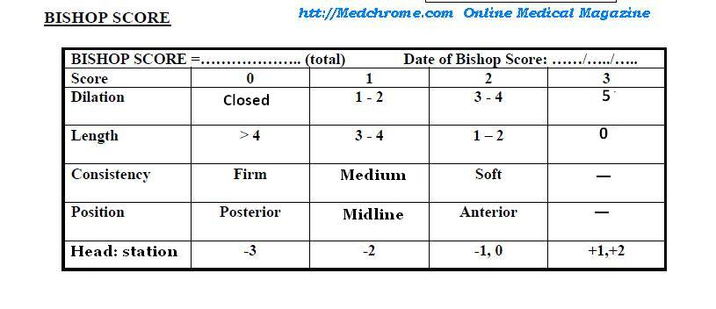
Modified Bishop’s Score
Favourable score->6 Best score-8

Slide 9
Methods of induction of labor
Membrane Sweeping
Prostaglandins
Amniotomy
Oxytocin
hygroscopic dilators, osmotic dilators (Laminaria japonicum), Foley catheters, double balloon devices, and extraamniotic saline infusion.

Slide 10
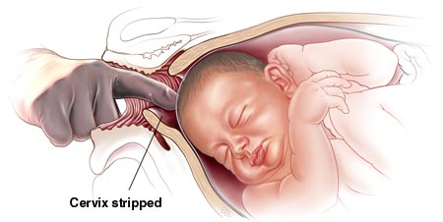
Membrane sweeping
Its possible only if the cervix has ripened to allow the passage of one finger.
Insertion of a gloved finger through the cervix and it’s rotation against the wall of the uterus.
Its strips off the chorionic membrane from the underlying decidua →releases PGS
Placenta previa should be excluded, Accidental amniotomy is a disadvantage.

Slide 11
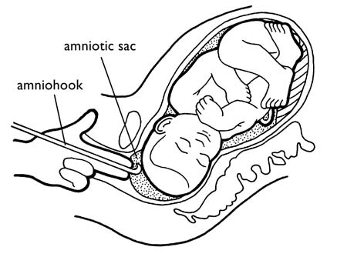
Amniotomy
AROM→stretching of the cervix & separation of the membranes → release of Prostaglandins
Depends on the state of the cervix and station of the presenting part
ADV:High success rate and chance to see the amniotic fluid
DIS: cannot be applied in an unfavourable cervix, possibility of cord prolapse

Slide 12
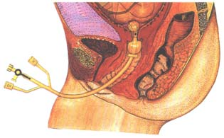
Balloon catheters
The Atad Ripener Device in place with the two balloons inflated. The uterine balloon is at the internal os and the cervicovaginal balloon is at the external os.

Slide 13
Amniotomy
CONTRAINDICATIONS:
1.IUD
2.HIV
HAZARDS:
1.Cord prolapse
2.Amnionitis
3.Amniotic fluid embolism
4. Abruptio placentae

Slide 14
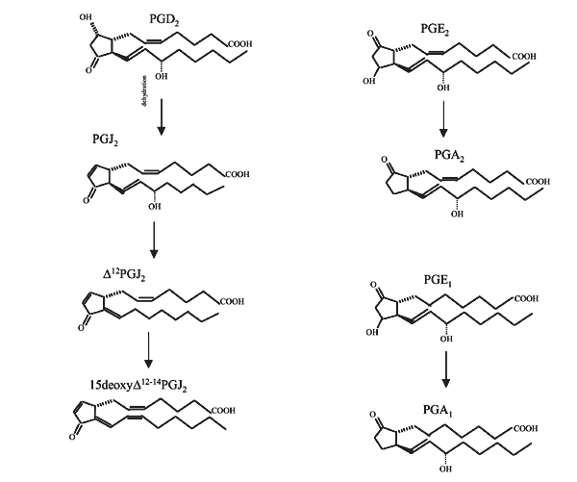
Prostaglandins
Chemistry:PG is a carboxylic acid synthetised from arachidonic acid.
Source: menstrual fluid, endometrium, decidua and amniotic membrane
TYPES
PGE1 -amnion
PGE2-amnion
PGF2-decidua and myometrium
PGI2-myometrium

Slide 15
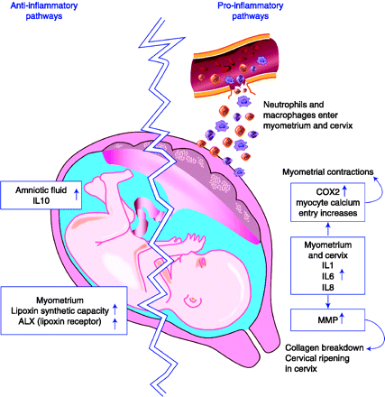
Mechanism of action
It causes change in the myometrial cell memb permeablity and alteration in the membrane bound calcium
It also sensitises the mometrium to the oxytocin
PGE2 has its collagenolytic activity→alter the ground substance of cervix→cx ripening

Slide 16
Prostaglandins
PGE1
Misoprostol
PGE2
Dinoprostone
(Cerviprime)

Slide 17
How to give Misoprostol?
Dose of 25 micro gram every 4hrly to a maximum of 6 doses can be given intravaginally
Dose of 50micro gram every 3hrs to a maximum of 6 doses can be given orally
Dose of 25micro gram every 2hrs can be given orally
Other routes of administration:
1.Buccal
2.rectal
3.sublingual

Slide 18
Oral Vs vaginal Misoprostol
ORAL
VAGINAL
Less effective when compared to vaginal PG
Chance of fetal distress is less
More effective when compared to oral route
Chance of fetal distress is more

Slide 19
Dinoprostone
Vaginal gel 0.5mg can be given intracervically.
It can be repeated after 6 hrs for 3 – 4 doses if required
Vaginal tab 3 mg can be given in the posterior fornix followed by 3mg after 6-8 hrs to a maximum dose of 6mg
Vaginal pessary releasing dinoprostone 10mg over 24hrs.It is removed when cx ripening is adequate

Slide 20
Misoprostol Vs Dinoprostone
Cheap & cost effective
Stable at room temp
Easy to administer
Costly
Need refrigeration

Slide 21
Contraindications of PGs
Bronchial asthma
Pulmonary disease
Previous uterine scar is relatively contraindicated

Slide 22
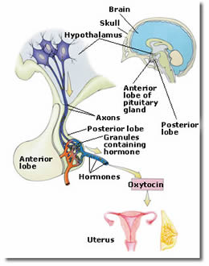
Oxytocin
It’s a nanopeptide synthetised in the supra optic and paraventricular nuclei of the hypothalamus.
Half life of 3-4 mins and duration of action 20 mins
Oxytocin is used very commonly to achieve induction of labour.
The objective is to produce uterine contractions that effectively produce cervical change and descent of the presenting part.

Slide 23
Mode of Action
1.It acts throgh the receptor and voltage gated calcium channel→myometrial contraction
2.It stimulates amniotic and decidual PG production
Preparations
Available in ampoules containing 5IU/ml
Buccal tab containing 50IU/ml
Nasal solution containing 40units/ml
Routes of administration:
1.I.V infusion
Intra muscular
Buccal tablets
Nasal spray

Slide 24
Oxytocin (syntocinon) should be used with extreme caution in multiparous women.
Oxytocin (syntocinon) should not be started for six hours following administration of vaginal prostaglandins
If a trial of labour is judged safe then Oxytocin may be used.
Oxytocin should be used with caution with a previous uterine scar.
Oxytocin should always be used in conjunction with the partogram once in established labour.
F
A
C
T
S

Slide 25
Advantages
Cheaper and effective
Easy titrable
Disadv:
.Needs refrigeration
.Effectiveness less with:
1. less Bishop score
2.IUD
3.lesser weeks of pregnancy

Slide 26
Hazards of oxytocin
Uterine hyperstimulation:
(Normal:3 contractions in 10 mins each lasting for 45secs)
(>5 contractions in 10mins each lasting for 1min)
Water intoxication:It due to
anti diuretic action(30-
40IU/ml).Manifested by
hyponatremia,confusion,coma
and CCF
Fetal distress
Uterine rupture
Hypotension

Slide 27
Failed Induction Of Labor
If Amniotomy is still impossible after a maximum no. of doses of Prostaglandins have been given or
If the cervix remains uneffaced and <3cm dilated after an Amniotomy has been performed &
Oxytocin has been running for 6-8hrs with regular contractions
Possible Causes
Placental Sulfatase deficiency
Lack of Essential Cytokines

Slide 28
Complications of IOL
Uterine Hyperstimulation
Uterine rupture
Maternal Upset
Iatrogenic Fetal Prematurity
Fetal Distress
Failed induction

Slide 29
CONCLUSION
during Induction of Labor,
B enefits should be weighed,
R isks should be assessed,
A lternatives should be considered,
N ecessity of intervention adjudged &
D ecision should be taken accordingly
BUT,
INJUDICIOUS USE of Labor Inducing agents should be avoided

Slide 30
THANK YOU

